Slide 1
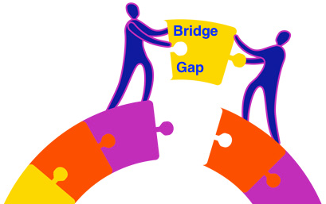
MakeTechEz
BridgeGap School Training Programme

Slide 2
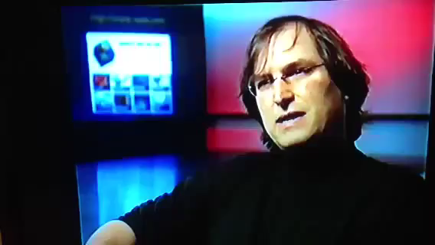
Steve Jobs “everyone should learn to program – teaches you to think”

Slide 3
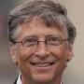
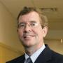
Leaders and trend-setters agree on one thing – Learn Programming
Bill Gates
Chairman, Microsoft
“Learning to write programs stretches your mind, and helps
you think better, creates a way of thinking about things that
I think is helpful in all domains.“
Dr. Alan Goodwin
Principal, Walt Whitman High School
“In the 21st century, learning to program computers is one
of the most valuable skills we can teach our young children,
no matter what career they choose. “
Source :- http://code.org/quotes

Slide 4

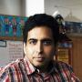
Leaders and trend-setters agree on one thing – Learn Programming
Eric Schmidt
Executive Chairman, Google
“For most people on Earth, the digital revolution hasn't even started yet. Within the next 10 years, all that will change. Let's get the whole world coding!“
Salman Khan
Founder, Khan Academy
“To prepare humanity for the next 100 years, we need more of our children to learn computer programming skills, regardless of their future profession. Along with reading and writing, the ability to program is going to define what an educated person is.“
Source :- http://code.org/quotes

Slide 5

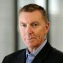
Leaders and trend-setters agree on one thing – Learn Programming
Harry Lewis
Dean of Harvard College (1995-2003)
“The most popular class at Harvard today is Intro to Computer Programming, because computers are helping in almost every other field of study and research - to search for a cure for cancer, to understand the origins of ancient languages, etc. We need more schools to offer computer programming; it's a skill that will empower the next generation in almost any field. Learning to code is easy, fun, and a good thing to learn young.“
Dr. John Deasy
Superintendent, Los Angeles Unified School District
“Students who study computer science unlock a world of opportunities for themselves.“
Source :- http://code.org/quotes

Slide 6

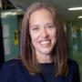
Leaders and trend-setters agree on one thing – Learn Programming
Stephen Hawking
Theoretical Physicist, Cosmologist, and Author
“Whether you want to uncover the secrets of the universe, or you just want to pursue a career in the 21st century, basic computer programming is an essential skill to learn.“
Wendy Kopp
CEO, Teach For America
“Ensuring that our nation's urban and rural children have the chance to become proficient in computer science is a sure way to set them on a trajectory to great career options. We need to do this to close the digital divide and level the playing field.“
Source :- http://code.org/quotes

Slide 7
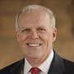
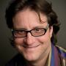
Leaders and trend-setters agree on one thing – Learn Programming
John Hennessy
President, Stanford University
“Learning to program is exciting: it's stimulating, fun, develops new ways of thinking, and in a very short time you can build programs that will impress your friends and family!“
Brad Feld
Managing Director, Foundry Group
“Computer science needs to be part of the core curriculum - like algebra, biology, physics, or chemistry. We need all schools to teach it, not just 10%.“
Source :- http://code.org/quotes

Slide 8
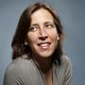

Leaders and trend-setters agree on one thing – Learn Programming
Susan Wojcicki
Senior Vice President, Google
“Learning to code makes kids feel empowered, creative, and confident. If we want our young women to retain these traits into adulthood, a great option is to expose them to computer programming in their youth.“
Jack Dorsey
Creator, Twitter. Founder and CEO, Square
“I think that great programming is not all that dissimilar to great art. Once you start thinking in concepts of programming it makes you a better person...as does learning a foreign language, as does learning math, as does learning how to read.“
Source :- http://code.org/quotes

Slide 9
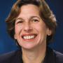
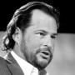
Leaders and trend-setters agree on one thing – Learn Programming
Randi Weingarten
President, American Federation of Teachers
“Computers have and continue to change the world around us, and programmers continue to be essential. Computer programming has become far more accessible to teach and learn and our country needs more students to learn it.“
Marc Benioff
Chairman and CEO, salesforce.com
“Learning to code at a young age opened my eyes to the incredibly exciting world of technology & entrepreneurship. Our youth deserve the opportunity to learn the skills that will enable them to succeed in our connected world.“
Source :- http://code.org/quotes

Slide 10

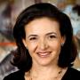
Leaders and trend-setters agree on one thing – Learn Programming
Mark Zuckerberg
Founder, Facebook
“Our policy at Facebook is literally to hire as many talented engineers as we can find. There just aren't enough people who are trained and have these skills today.“
Sheryl Sandberg
Chief Operating Officer, Facebook
“An understanding of computer science is becoming increasingly essential in today’s world. Our national competitiveness depends upon our ability to educate our children – and that includes our girls – in this critical field.“
Source :- http://code.org/quotes

Slide 11

Employment Opportunities
Revenues in the IT-ITES sector are expected to grow from $108 billion to $300 billion in seven years. Correspondingly NASSCOM predicts employment rate will spur from 3 million currently to 10 million Jobs by 2020.

Slide 12
Current Skill Gap
Only 3.51% of Fresh Graduating Engineers are currently appropriately trained to be directly deployed on IT Projects and 2.68% are employable in IT product companies
Source - National Employability Report (NER)

Slide 13

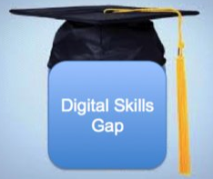

What we at BridgeGap See
HUGE OPPORTUNITY ahead for School Kids
BIG SKILL GAP currently exists
START EARLY to Programming

Slide 14

What is BridgeGap School Training Programme?
BridgeGap School Training
BridgeGap School Training Programme is a extended school activity to help 7th, 8th and 9th Graders learn Programming Skills.
BridgeGap for Schools is a Hands-on Programme with complete emphasis on Lab Work and Programming.

Slide 15
What is BridgeGap School Training Programme?
BridgeGap School Training
BridgeGap a 3 year Programme, 1st and 2nd Year the focus is on Core Programming Languages (C++ and Java) and the final year is on Web and Mobile Programming.
Mentors will be Architects and Technology Experts from the Industry.

Slide 16
What is BridgeGap School Training Programme?
BridgeGap School Training
BridgeGap Training is one hour per week through out the academic year. Students work in Pair.
The complete training content is available online. Students are encouraged to use Online Platform to learn, share and help using blog messages.

Slide 17

How BridgeGap Training Programme Works?
Content Design –
Introduces Concepts mainly by writing and compiling lot of programs than reading lot of theory. Its Learning by being Hands-on
Each Level has 18 Steps and Every Step introduces 5 - 10 Concepts. Each concept is demonstrated with a sample code which are built, compiled and executed by the students.
At the end of each step students write Practice Programs verified by the Mentor.
At the End of each level, Students would have written any-where between 150 - 200 Programs

Slide 18

How BridgeGap Training Programme Works?
Content Mentoring –
Mentors are Architects and Technology Experts from the industry helping students on the sample and the practice programs.
In addition to the mentor there will be 2 Training Assistants assisting the mentor and helping the students to program and compile.
Internally our Mentors are called
Dronaacharya

Slide 19
How BridgeGap Training Programme Works?
Content Delivery –
It’s a Class-Room Training on extended hours at the School Premise.
Each Class has 30 Students working in Pair. Pair programming is a collaborative learning method in which students program in pairs instead of individually. This approach significantly improves students programming competency
The complete Training Content is online. Students are encouraged to participate, comment, learn and share their knowledge using online Blog Messaging.

Slide 20
Thank you
MakeTechEz
BridgeGap School Training Programme

